Slide 1







An All-Island eHealth Hub for Cancer
AICRI Showcase: Vision and Progress
Wednesday, 28th September 2022
Herbert Park Hotel, Dublin
eHealth-Hub: All Island Research Hub for Federated Analysis of Cancer Data
Emerging Hub of Excellence
eHealth@ul.ie
Prof. Aedín Culhane
Professor of Cancer Genomics,
Director, Limerick Digital Cancer Centre
University of Limerick
aedin.Culhane@ul.ie @AedinCulhane

Slide 2


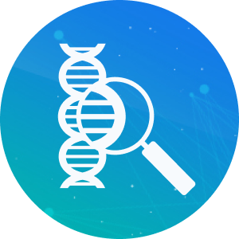
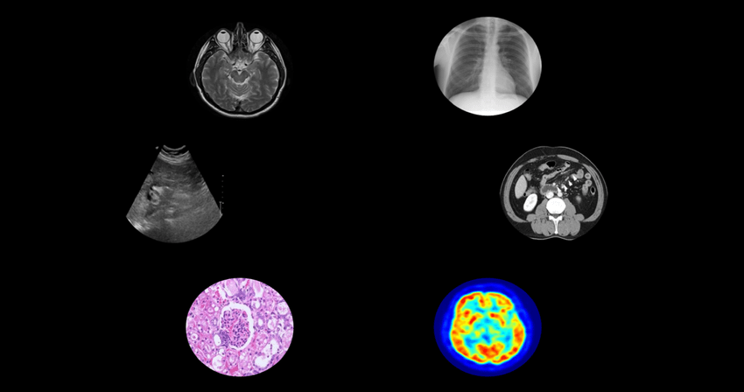

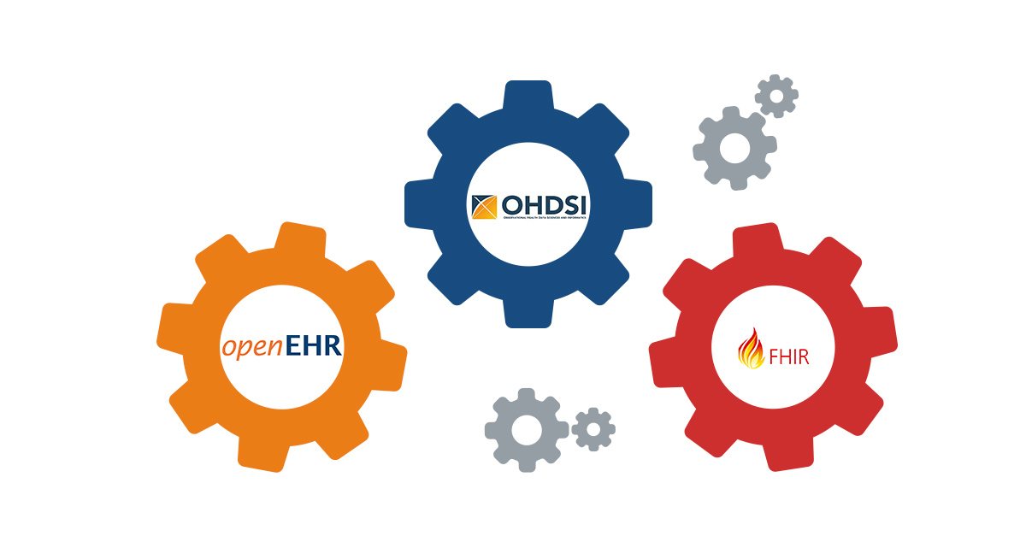
Background: Cancer Clinical Genomic Informatics Research
Development & implementation of genomics-based clinical informatics need
patient history
clinical data
genetics and genomics assays
imaging
treatment data
Frameworks that enable sharing of all-island cancer data facilitate
All-island clinical cancer research
Real-time data to support policy decisions
Enables meta-analysis, disparity research
Increase sample size, > statistical power
Connects Irish data to EU and global research
Federated GDPR compliant frameworks such as the OHDSI common data model are used in EU countries.
Over 1 billion patients records are mapped to the OMOP common data model and are used in observational health research. Framework such as HL7 FHIR enable data sharing.

Slide 3
Background: eHealth Hub harnessing all-island expertise to drive cancer digital health research
UL is a collaborator in OHDSI, a global leader in R/Bioconductor, experienced in development of open-source software in cancer genomics research
Northern Ireland has the most advanced electronic health and social care records in the UK. The Northern Ireland Trusted Research Environment provides safe and effective use of data. QUB work on COVID-19 and cancer has gained international recognition
QUB expertise in secure connected intelligence and health data research combines with UL leadership and experience in OHDSI, Bioconductor and open-source science provides a strong foundation to develop robust eHealth frameworks for harmonization of electronics health records to advance cancer digital health research

Slide 4

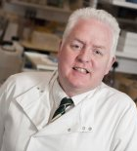
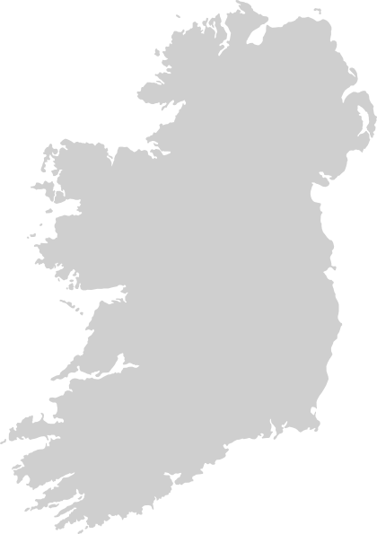

Partners: harnessing all-island expertise to drive cancer digital health research
UL is a collaborator in OHDSI, a global leader in R/Bioconductor, experienced in development of open-source software in cancer genomics research
Northern Ireland has the most advanced electronic health and social care records in the UK. The Northern Ireland Trusted Research Environment provides safe and effective use of data. QUB work on COVID-19 and cancer has gained international recognition
QUB expertise in secure connected intelligence and health data research combines with UL leadership and experience in OHDSI, Bioconductor and open-source science provides a strong foundation to develop robust eHealth frameworks for harmonization of electronics health records to advance cancer digital health research
Mark Lawler (QUB)
Heterogeneous
Cancer EHR Data
eHealthHub
For Cancer
Aedin Culhane (UL)

Slide 5

















Progress to Date (April – September 2022)
Mark Lawler (QUB)
eHealthHub
For Cancer
€4 Million
Memorandum between
Universities signed
DPIA/ethics initiated
Initial meeting with OHDSI,
EDHEN training academy and
DARWIN EU representatives
UL Partner in HRB B1+MG federated
sharing of genomes
Aedin Culhane (UL)

Slide 6
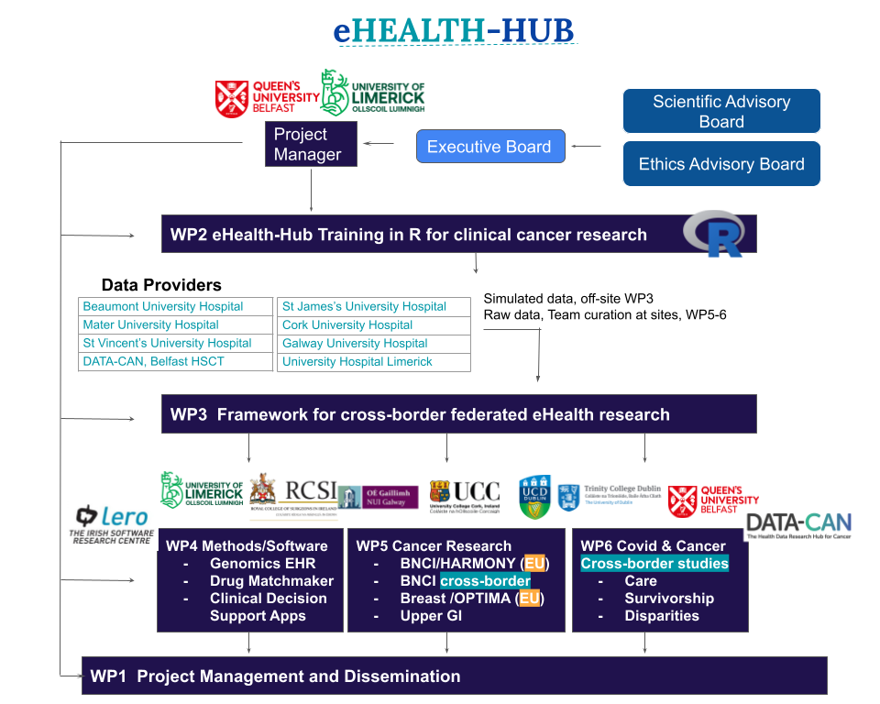
Key Future Activities of the Project
Participation in US annual OHDSI conference in Washington DC (October)
Data Protection, Ethics
Hiring Training of
10 PhD Students
4 Post doctoral Fellow
7 Research Assistants
eHealthHub
For Cancer
Email us at: ehealth@ul.ie

